Slide 1

ECEN 361
Real-Time and Embedded Systems
Lecture 4 – A/D, DACs, DSP

Slide 2
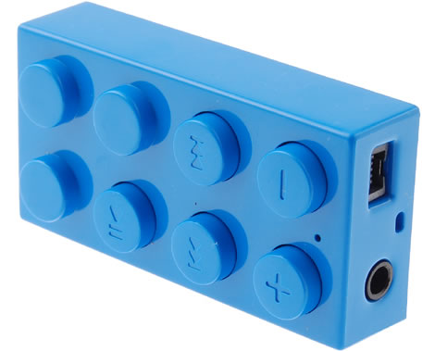
External Signals
We need to interface with the outside World
What do we consider?
We must talk about the actual application
How about an Audio Player

Slide 3
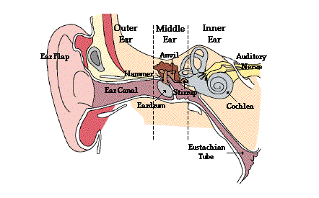
Human Hearing
Who knows how an ear works?

Slide 4
Human Hearing Cont
The outer ear consists of the ear canal and the ear flap. These structures direct sounds to the middle and inner ear
Stretched across the middle ear is a thin sheet of tissue called the tympanic membrane or ear drum
Sound waves striking the ear drum cause it to vibrate
The vibrating ear drum transfers its energy into the cochlea where it is converted to neural impulses

Slide 5
Human Hearing Cont
What is the range of human hearing?
The range of human hearing is optimistically considered to be 20Hz to 20kHz
It is far more sensitive to 200Hz - 4 kHz signals
What about the intensity of human hearing?
The intensity of human hearing is between
10⁻¹⁸ Watts/cm² to 10⁻² Watts/cm²

Slide 6
How do we get sound into/out of a computer?
Most of the signals directly encountered in science and engineering are continuous:
Music from a Piano
Light intensity
Voltage that changes over time
etc
Analog to Digital Conversion (ADC’s) and Digital to Analog Conversion (DAC’s) are the processes that allow digital computers to interact with these everyday signals.

Slide 7
Analog to Digital Conversion
Input is analog signal
Output is binary number
Many Technologies of ADC’s
Delta Sigma
Successive Approximation
Digital Ramp
Flash
Tracking
etc

Slide 8
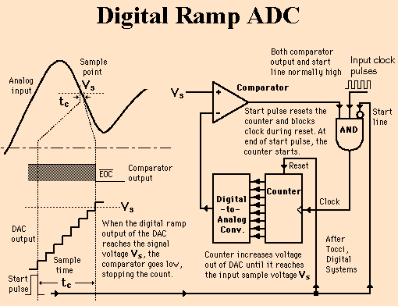
Types of ADC’s

Slide 9
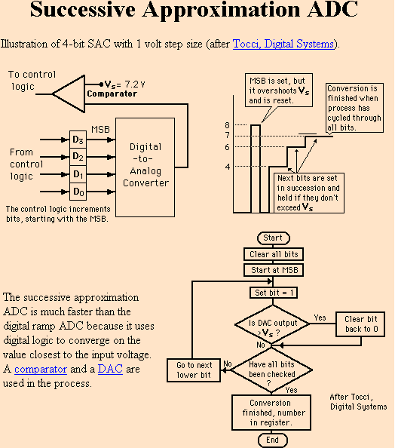
Types of ADC’s

Slide 10
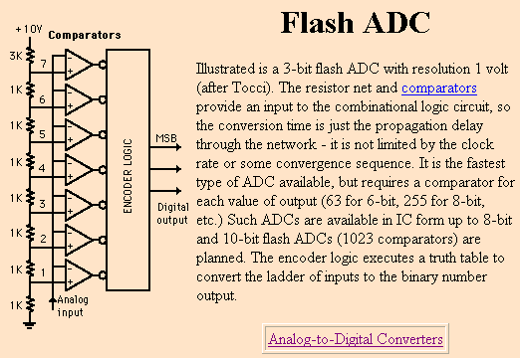
Types of ADC’s

Slide 11
Digital Signals
When you sample an analog signal with an ADC you have control over what 2 variables?
Sampling rate - controls how many samples are taken per second
Sampling precision - controls how many different gradations (quantization levels) are possible when taking the sample
Digital recordings are always approximations of the analog case.
BUT by increasing the sample rate and sampling precision (also called resolution) we can obtain an accurate recording

Slide 12
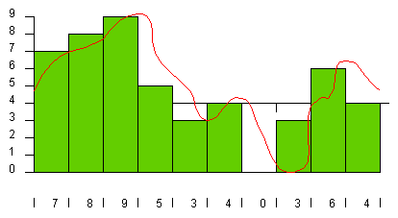
ADC - Example
Sample Precision = 10
Sample Rate = 1
Sampling Error =
High
What happens if we increase the sampling rate?
What happens if we increase the sampling precision?

Slide 13
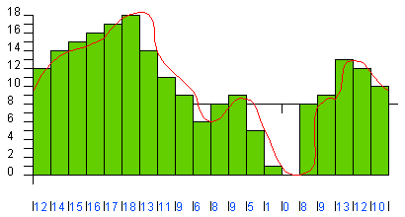
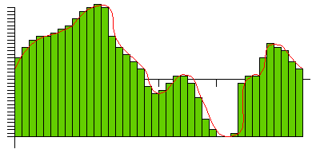
ADC - Example
Sample Precision = 20
Sample Rate = 2
Sampling Error = Better
Sample Precision = 40
Sample Rate = 4
Sampling Error = Better again

Slide 14
ADC Input Filters
Most ADC systems have a low pass analog filter just before the ADC. Why?
Amplitude
20kHz
Freq

Slide 15
Digital to Analog Conversion
Exact opposite of A/D conversion
Input is binary number
Output is analog signal
Several Technologies of DAC’s
Delta Sigma
Summing Amplifier
R-2R Ladder
etc

Slide 16
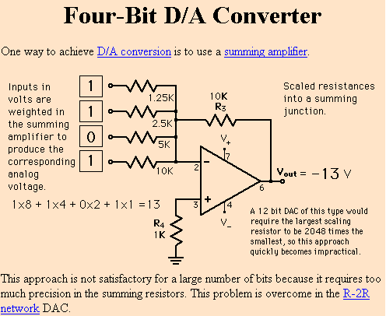
Types of DAC’s

Slide 17
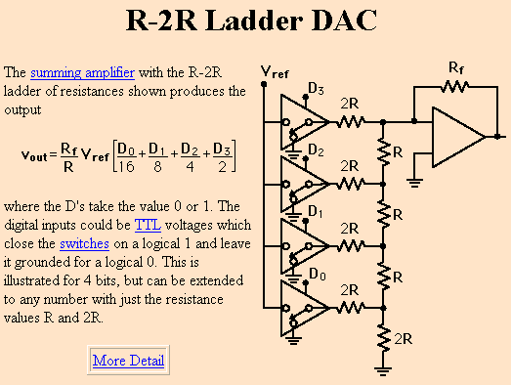
Types of DAC’s

Slide 18
Digital to Analog Conversion
DAC’s construct the analog signal from the digital bits
When you construct an analog signal with a DAC you have control over 2 variables (just like the ADC):
Conversion rate - controls how many conversions are done per second – Higher conversion rate, higher accuracy (needs to be at least 2x highest frequency)
Conversion precision - controls how many different gradations (quantization levels) are possible when constructing the signal – Greater # level’s -> lower SNR

Slide 19
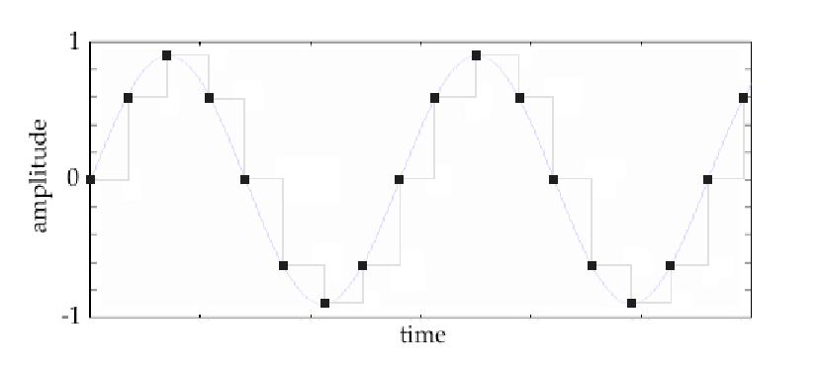
DAC Output Filters
Most DAC systems have an analog low pass filter on the output of the DAC. Why?

Slide 20
Audio Processing
Sound Quality Required | Bandwidth | Sampling Rate | Number of Bits | Data Rate (bits/sec) | Comments
High Fidelity Music (CD’s) | 20 Hz to 20 kHz | 44.1 kHz | 16 | 44.1kHz* 16bits*2 channels= 1.411M bits/sec | Satisfies even the most picky person (better than human hearing)
Telephone Quality Speech | 200 Hz to 3.2 kHz | 8 kHz | 12 | 8kHz* 12bits= 96k bits/sec | Good speech quality but poor for music

Slide 21
Why 44.1 kHz?
What is the range of hearing for humans?
Nyquist Theorem
To represent a signal, the sampling rate needs to be at least twice the highest frequency contained in the signal
Example,
If Input freq = 8kHz
Then Sample Rate >= 16kHz

Slide 22
Why 16 bits?
A sample is a snapshot of the instantaneous amplitude, and that snapshot is stored as a number.
The more bits -> the greater the accuracy
As measured by signal to noise ratio (SNR)

Slide 23
Signal To Noise Ratio
What does SNR mean?
SNR = 20log(V_{signal}/V_{noise})
Each bit adds about 6dB of resolution.
16-bits has an SNR of 98 dB
8-bits has an SNR of 50 dB

Slide 24
Audio Signals Summary
The more bits we use, the more accurate our recording.
But each time our accuracy increases, so do our storage requirements.
Sometimes we don’t need to be that accurate
there are lots of options open to us when playing with digital sounds.
This is where audio coding and compression techniques come into place, and one of the places where human audio perception and signal processing meet

Slide 25
Audio DAC’s and ADC’s
Audio DAC’s and ADC’s are a class of DAC’s/ADC’s. They have
a minimum of 16 bit’s resolution
a minimum of 44kHz sampling/conversion
Very good signal to noise ratio
Lots of companies make audio quality DAC’s/ADC’s
TI
Analog
Philips
Freescale
etc

Slide 26
Audio Codec’s
There is some different terminology in the industry concerning what the term Audio Codec refers to
To MS, a codec is a piece of SW that translates an audio file into a different format
In our world, the audio codec is a piece of hardware
It contains both DAC’s and ADC’s on a single chip
The DAC’s and ADC’s are stereo – meaning at least
2 channels for input (Left and Right)
2 channels for output (Left and Right)

Slide 27
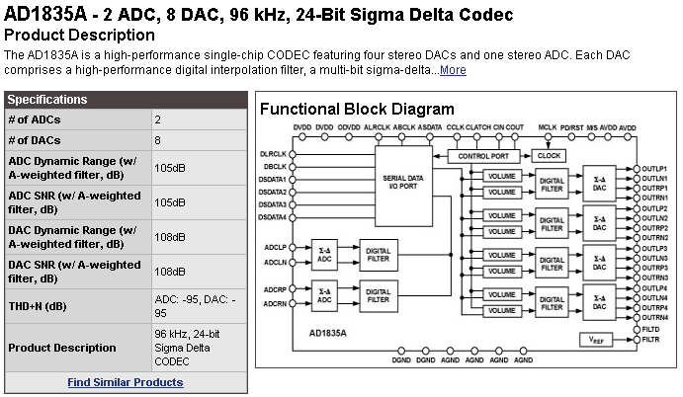
Audio Codec - Example
How do you think we could hook this up to the BF533?

Slide 28
Backup

Slide 29
Analog to Digital Conversion
ADC’s “sample” the analog signal
A sample is a snapshot of a signal. This snapshot includes both amplitude and time information.

Slide 30
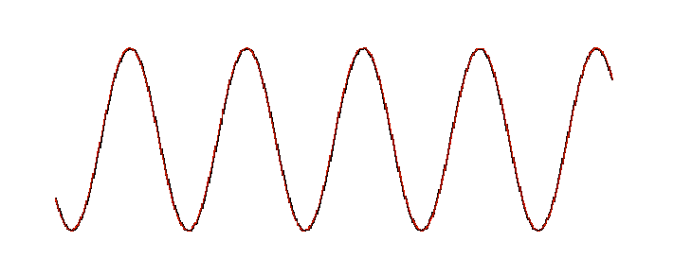
Why Twice?

Slide 31
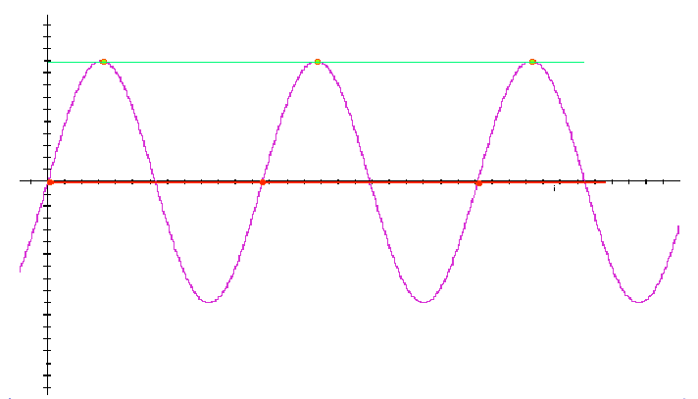
One time per cycle

Slide 32
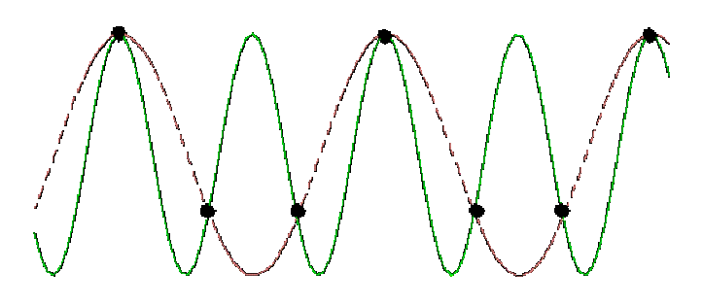
1.5 Times Per Cycle

Slide 33
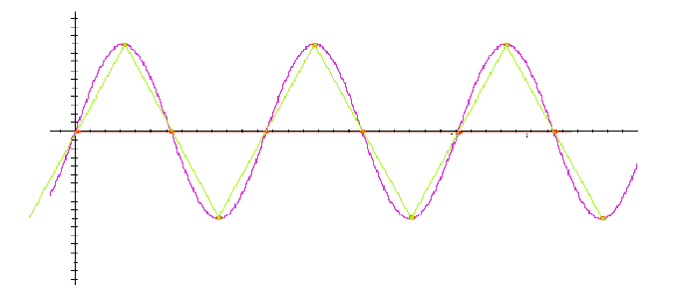
2 Times Per Cycle

Slide 34
Quality Versus Size
Sample Rate Quantization | 44.1 kHz | 22.05 kHz | 11.025 kHz
16 bit | 10.1 Mb | 5.05 Mb | 2.52 Mb
8 bit | 2.52 Mb | 1.26 Mb | 630 Kb
Note: these are relative file size’s

Slide 35
CD’s
CD rate is 44,100 samples per second
16-bit samples
Stereo uses 2 channels
Number of bytes for 1 minute is
2 X (16/8) X 60 X 44100 = 10.584 Mbytes

Slide 36
MPEG and MP3
MPEG is an acronym for the Moving Pictures Experts Group
a working group consisting of the International Standards Organization (ISO) and the International Electro-Technical Commission (IEC).
works to develop "international standards for compression, decompression, processing, and coded representation of moving pictures, audio and their combination."
MPEG-1 audio layer-3 (i.e. MP3), is a subsystem of one set of standards promulgated by MPEG dealing exclusively with audio compression
MP3 is a method of compressing music and other "high fidelity" audio to allow fast and efficient transmission over the Internet and telecommunication systems
It is a lossy compression algorithm

Slide 37
Watchdog Timer
Data, Address Bus and Cntrl
CPU
Glue logic
RST
Reset
WatchDog
Restart
What kind of glue logic is this?

Slide 38
DMA’s
Direct Memory Access (DMA)
Circuitry that can read/write data to/from an IO device and memory
Independent from processor
Need to have arbitration between DMA and processor

Slide 39
DMA
Address Bus (rd/ wr/)
CPU
RAM
Data Bus
Bus REQ
Bus ACK
DMA
IO
DMAREQ

Slide 40
DMA Timing
DMA Request
Bus Request
Bus Ack
Read
Write
IO Device drives the data bus
DMA drives the data bus
D0-Dn
A0-An
DMA drives IO device address on the bus
DMA drives memory device address on the bus

Slide 41
Timings
We have hooked up both SRAM and Flash to our processor. How fast is the interface for each of these?
How can we ensure these devices are fast enough to talk to the microprocessor?
3 Methods
Wait states – figure 3.6 and 3.7
Wait signal – figure 3.5
Buy fast enough parts - $$$

Slide 42
Timings
Typical Bus Read Cycle
T1
T2
T3
Clock
A0-An
RD’
D0-Dn
End of bus cycle
uP reads data from bus
Memory drives data bus
uP drives RD low
uP drives Address bus to start bus cycle

Slide 43
Timings
2-Wait State Bus Cycle
T1
T2
Tw
Tw
T3
Clock
A0-An
RD’
D0-Dn
End of bus cycle
uP reads data from bus
Memory drives data bus
uP drives RD low
uP drives Address bus to start bus cycle

Slide 44
Timings
Wait Signal Bus Cycle
T1
T2
T3
Clock
A0-An
RD’
D0-Dn
WAIT
The slow device can assert WAIT as long as it needs, and the uP will wait

